Slide 1


Data Synthesis based on
Generative Adversarial Networks
Xue Huanran 1701214297
2018.11.19

Slide 2

Motivation
Peking University
In the big era, privacy should be the top priority in the process to protect people who were willing to share information.
In fact, it is very difficult to simultaneously achieve good privacy and usability levels after anonymization or other modifications.
Generative Adversarial Networks (GANs) have shown significant improvements over other generative models in image and text datasets.
In this paper, the method named table-GAN, is specialized for synthesizing tables than contain categorical, discrete and continuous values.

Slide 3
Notations
Peking University
● table A table of a relational database. It consists of attributes and records.
● identifier An attribute that assigns a unique number to each record, such as social security number (SSN).
● quasi-identifier (QID) QID is not a unique identifier, however, a combination of QIDs is occasionally sufficient to identify a record, such as occupation, age, and ZIP code.
● sensitive attribute All other attributes except for identifiers and QIDs, such as grade point average (GPA), salary, disease status, and so on.

Slide 4
Related Work

Slide 5
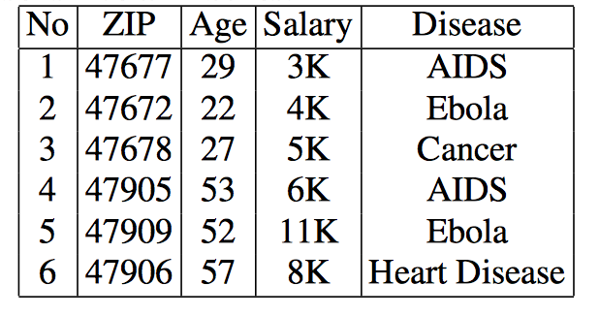
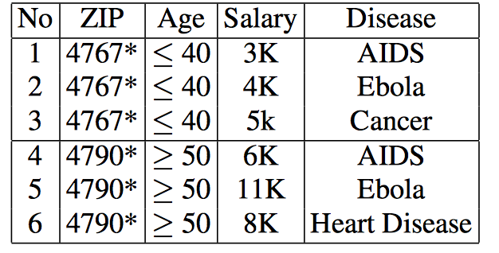
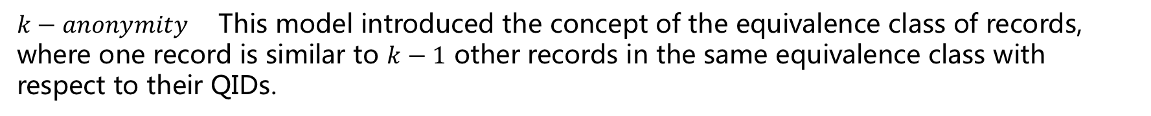
Privacy Preserving Method
Peking University
$k−anonymity$ This model introduced the concept of the equivalence class of records, where one record is similar to $k−1$ other records in the same equivalence class with respect to their QIDs.
QIDs
Sensitive Attributes
(a) Original Table
(b) Table anonymized by 3-anonymity and 3-diversity

Slide 6
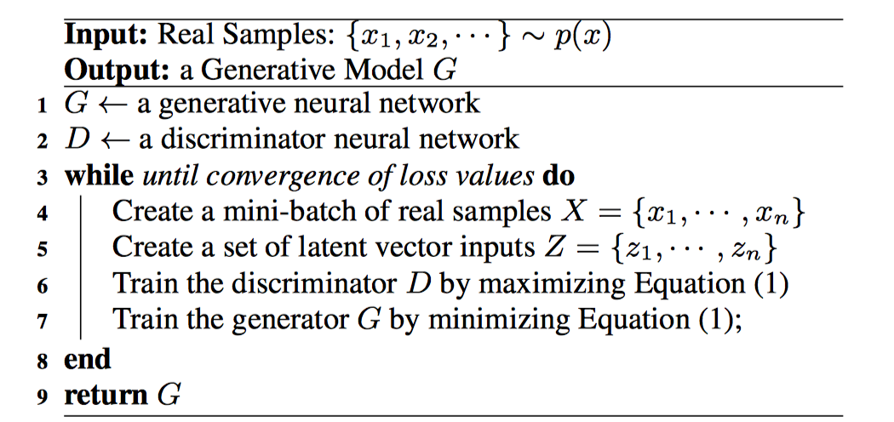
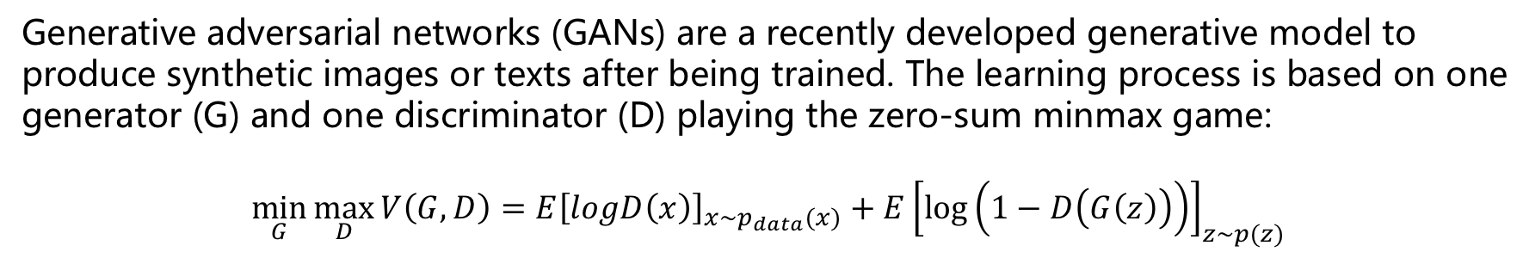
Generative Adversarial Network
Peking University
Generative adversarial networks (GANs) are a recently developed generative model to produce synthetic images or texts after being trained. The learning process is based on one generator (G) and one discriminator (D) playing the zero-sum minmax game:
$$\min_{G}{\max_{D}{V\left(G,D\right)=E{\left[logD\left(x\right)\right]}_{x\sim p_{data}(x)}+E{\left[\log\left(1−D\left(G\left(z\right)\right)\right)\right]}_{z\sim p(z)}}}$$

Slide 7
Proposed Method

Slide 8
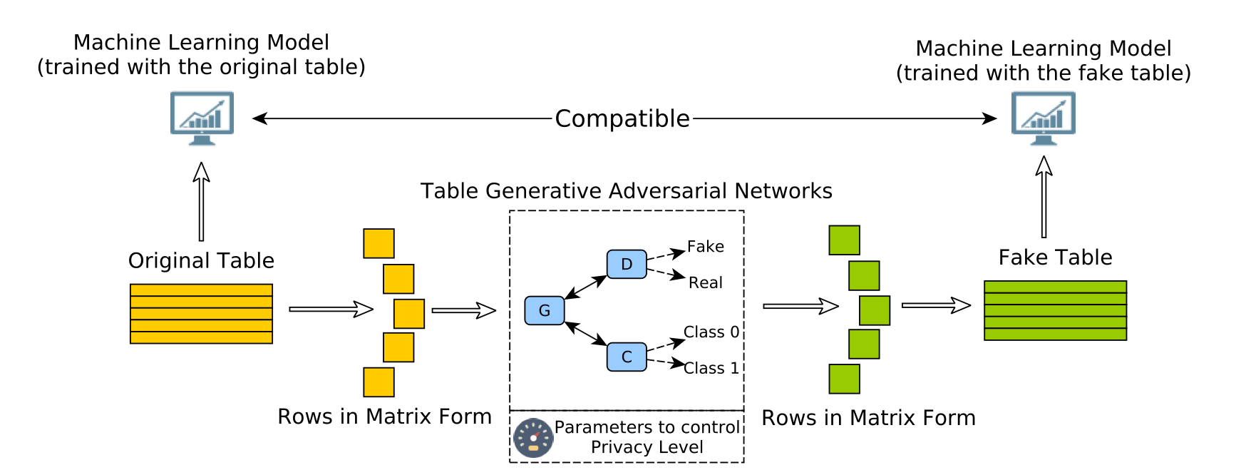
Overall Architecture
Peking University

Slide 9
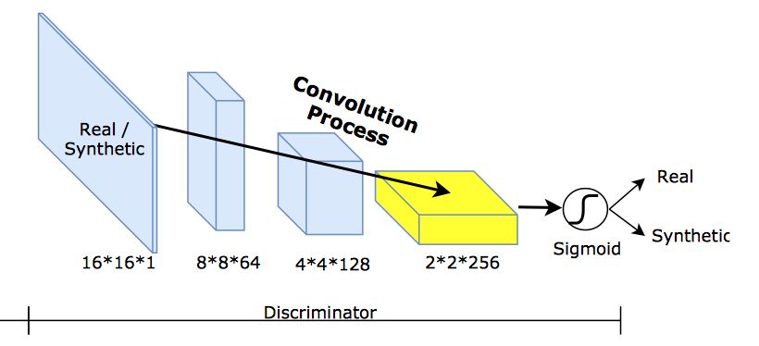
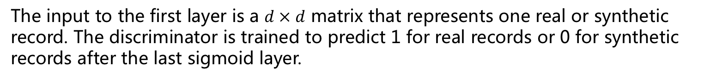
Discriminator
Peking University
The input to the first layer is a $d × d$ matrix that represents one real or synthetic record. The discriminator is trained to predict 1 for real records or 0 for synthetic records after the last sigmoid layer.

Slide 10
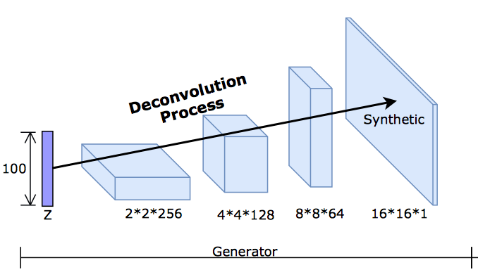
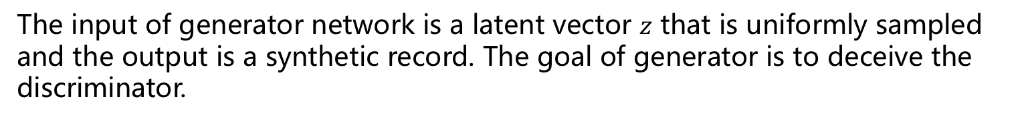
Generator
Peking University
The input of generator network is a latent vector $z$ that is uniformly sampled and the output is a synthetic record. The goal of generator is to deceive the discriminator.

Slide 11
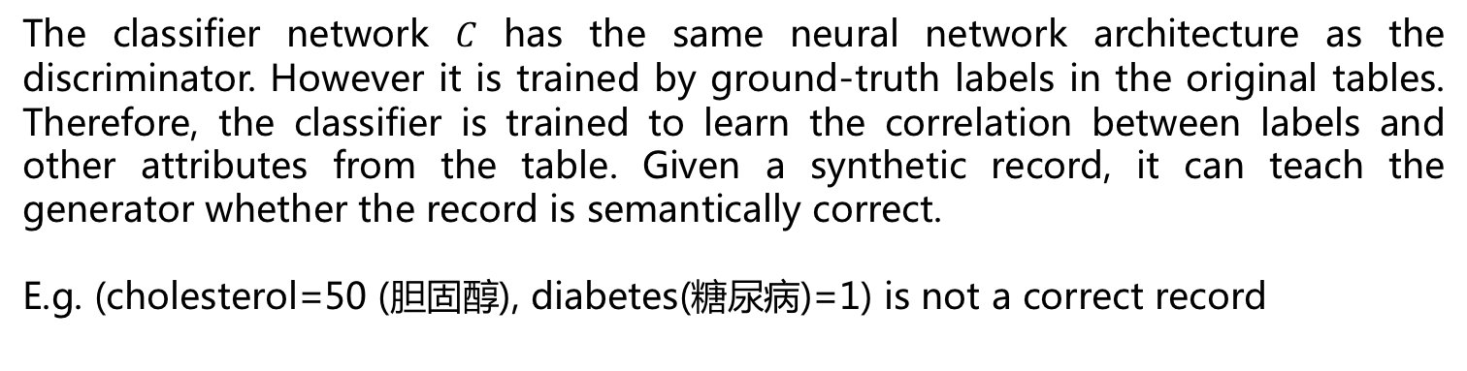
Semantic Classifier
Peking University
The classifier network $C$ has the same neural network architecture as the discriminator. However it is trained by ground-truth labels in the original tables. Therefore, the classifier is trained to learn the correlation between labels and other attributes from the table. Given a synthetic record, it can teach the generator whether the record is semantically correct.
E.g. (cholesterol=50 (胆固醇), diabetes(糖尿病)=1) is not a correct record

Slide 12
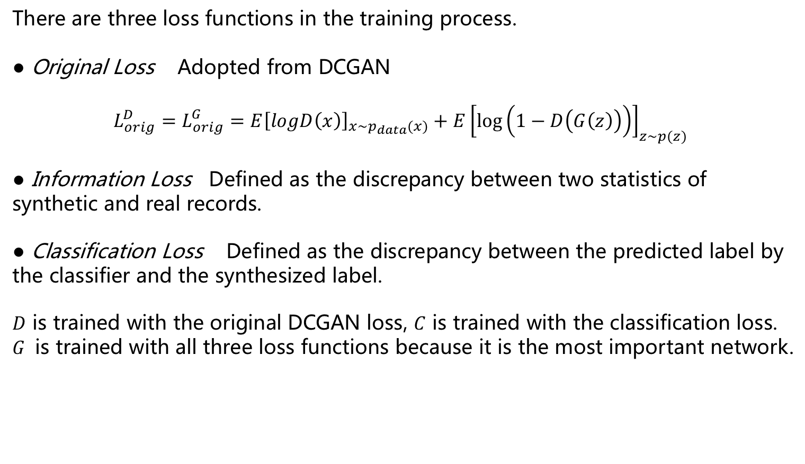
Loss Functions
Peking University
There are three loss functions in the training process.
● Original Loss Adopted from DCGAN
$$L_{orig}^{D}=L_{orig}^{G}=E{\left[logD\left(x\right)\right]}_{x\sim p_{data}(x)}+E{\left[\log\left(1−D\left(G\left(z\right)\right)\right)\right]}_{z\sim p(z)}$$
● Information Loss Defined as the discrepancy between two statistics of synthetic and real records.
● Classification Loss Defined as the discrepancy between the predicted label by the classifier and the synthesized label.
$D$ is trained with the original DCGAN loss, $C$ is trained with the classification loss. $G$ is trained with all three loss functions because it is the most important network.

Slide 13
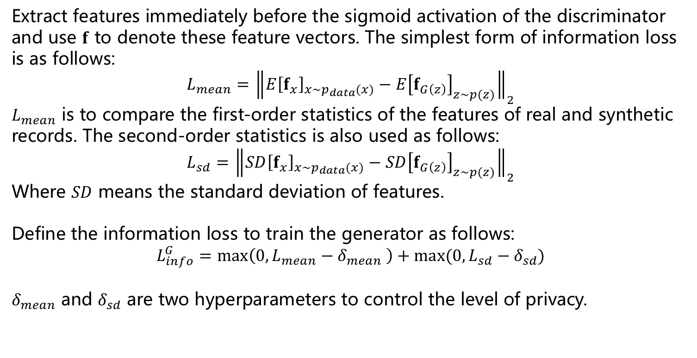
Information Loss
Peking University
Extract features immediately before the sigmoid activation of the discriminator and use $f$ to denote these feature vectors. The simplest form of information loss is as follows:
$$L_{mean}={\left\|E{\left[f_{x}\right]}_{x\sim p_{data}(x)}−E{\left[f_{G\left(z\right)}\right]}_{z\sim p(z)}\right\|}_{2}$$
$L_{mean}$ is to compare the first-order statistics of the features of real and synthetic records. The second-order statistics is also used as follows:
$$L_{sd}={\left\|SD{\left[f_{x}\right]}_{x\sim p_{data}(x)}−SD{\left[f_{G\left(z\right)}\right]}_{z\sim p(z)}\right\|}_{2}$$
Where $SD$ means the standard deviation of features.
Define the information loss to train the generator as follows:
$$L_{info}^{G}=\max\left(0,L_{mean}−δ_{mean} \right)+max⁡(0,L_{sd}−δ_{sd})$$
$δ_{mean}$ and $δ_{sd}$ are two hyperparameters to control the level of privacy.

Slide 14
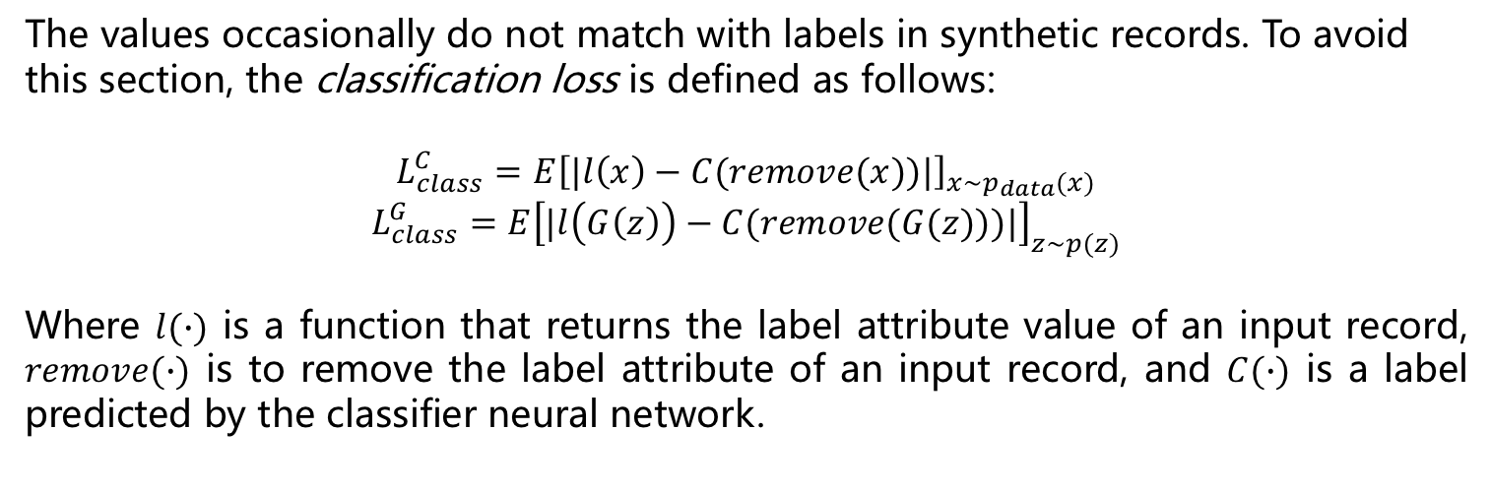
Classification Loss
Peking University
The values occasionally do not match with labels in synthetic records. To avoid this section, the classification loss is defined as follows:
$$L_{class}^{C}=E{\left[|l\left(x\right)−C(remove(x))|\right]}_{x\sim p_{data}(x)}$$
$$L_{class}^{G}=E{\left[|l\left(G\left(z\right)\right)−C(remove(G(z)))|\right]}_{z\sim p(z)}$$
Where $l(∙)$ is a function that returns the label attribute value of an input record, $remove(∙)$ is to remove the label attribute of an input record, and $C(∙)$ is a label predicted by the classifier neural network.

Slide 15
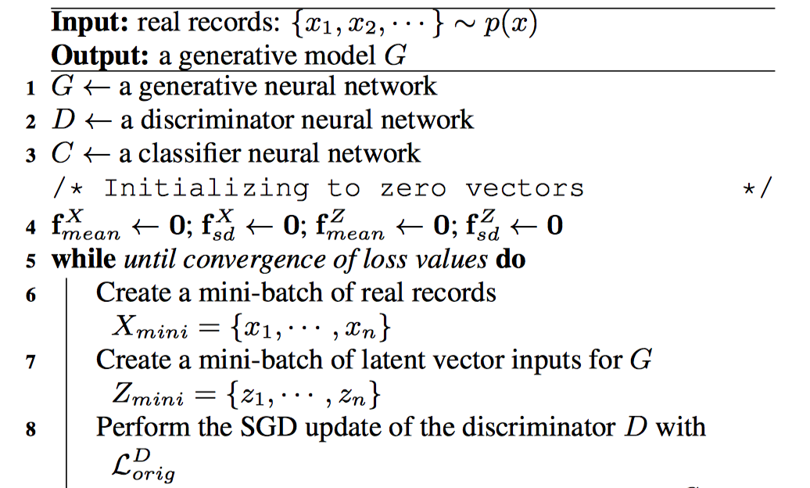
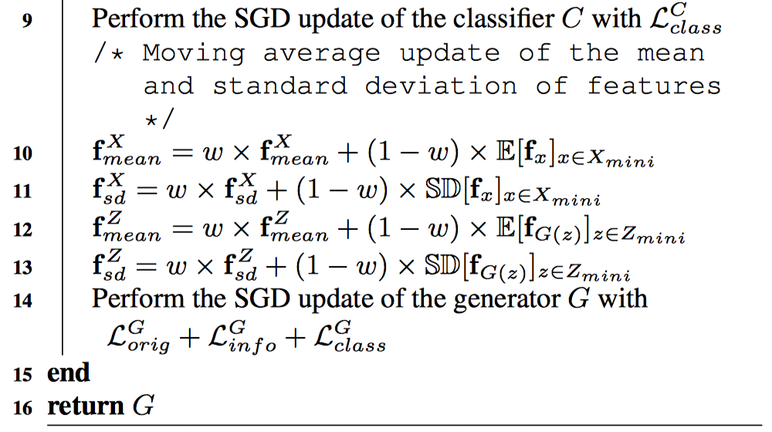

Training Algorithms
Peking University
After early stopping, the final winner group is $S$

Slide 16
Experimental Analysis

Slide 17
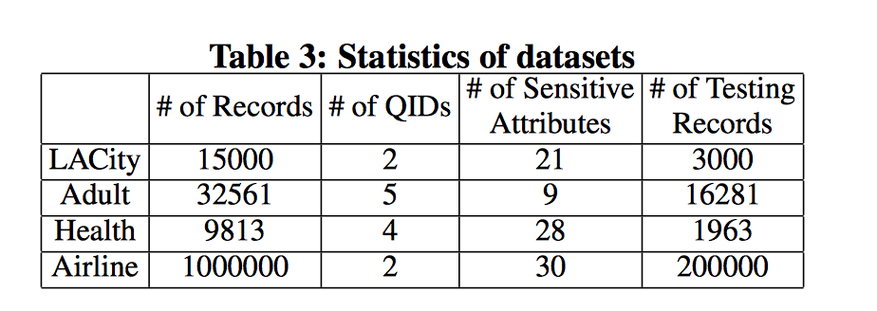
Dataset
Peking University

Slide 18
Baseline Methods
Peking University
● ARX A powerful anonymization tool that is widely used in real applications and research. All methods in ARX do not change sensitive attributes.
● sdcMicro The sensitive attributes are changed in sdcMicro.
● condensation A method for generating synthetic records.
● DCGAN A famous GAN Architecture which uses CNN.

Slide 19
Evaluation Method
Peking University
● Statistical Comparison Compare statistical similarity between an attribute in the original table and the synthetic table (CDF in this paper).
● Machine Learning Score Similarity After fixing a classification or regression algorithm and its parameter, train with the original table or the synthesized table. If the accuracy values of the two cases for unknown testing cases are the same, then we can say that they are compatible. F1 score is used for classification tests and mean relative error (MRE) is used for regression tests.

Slide 20
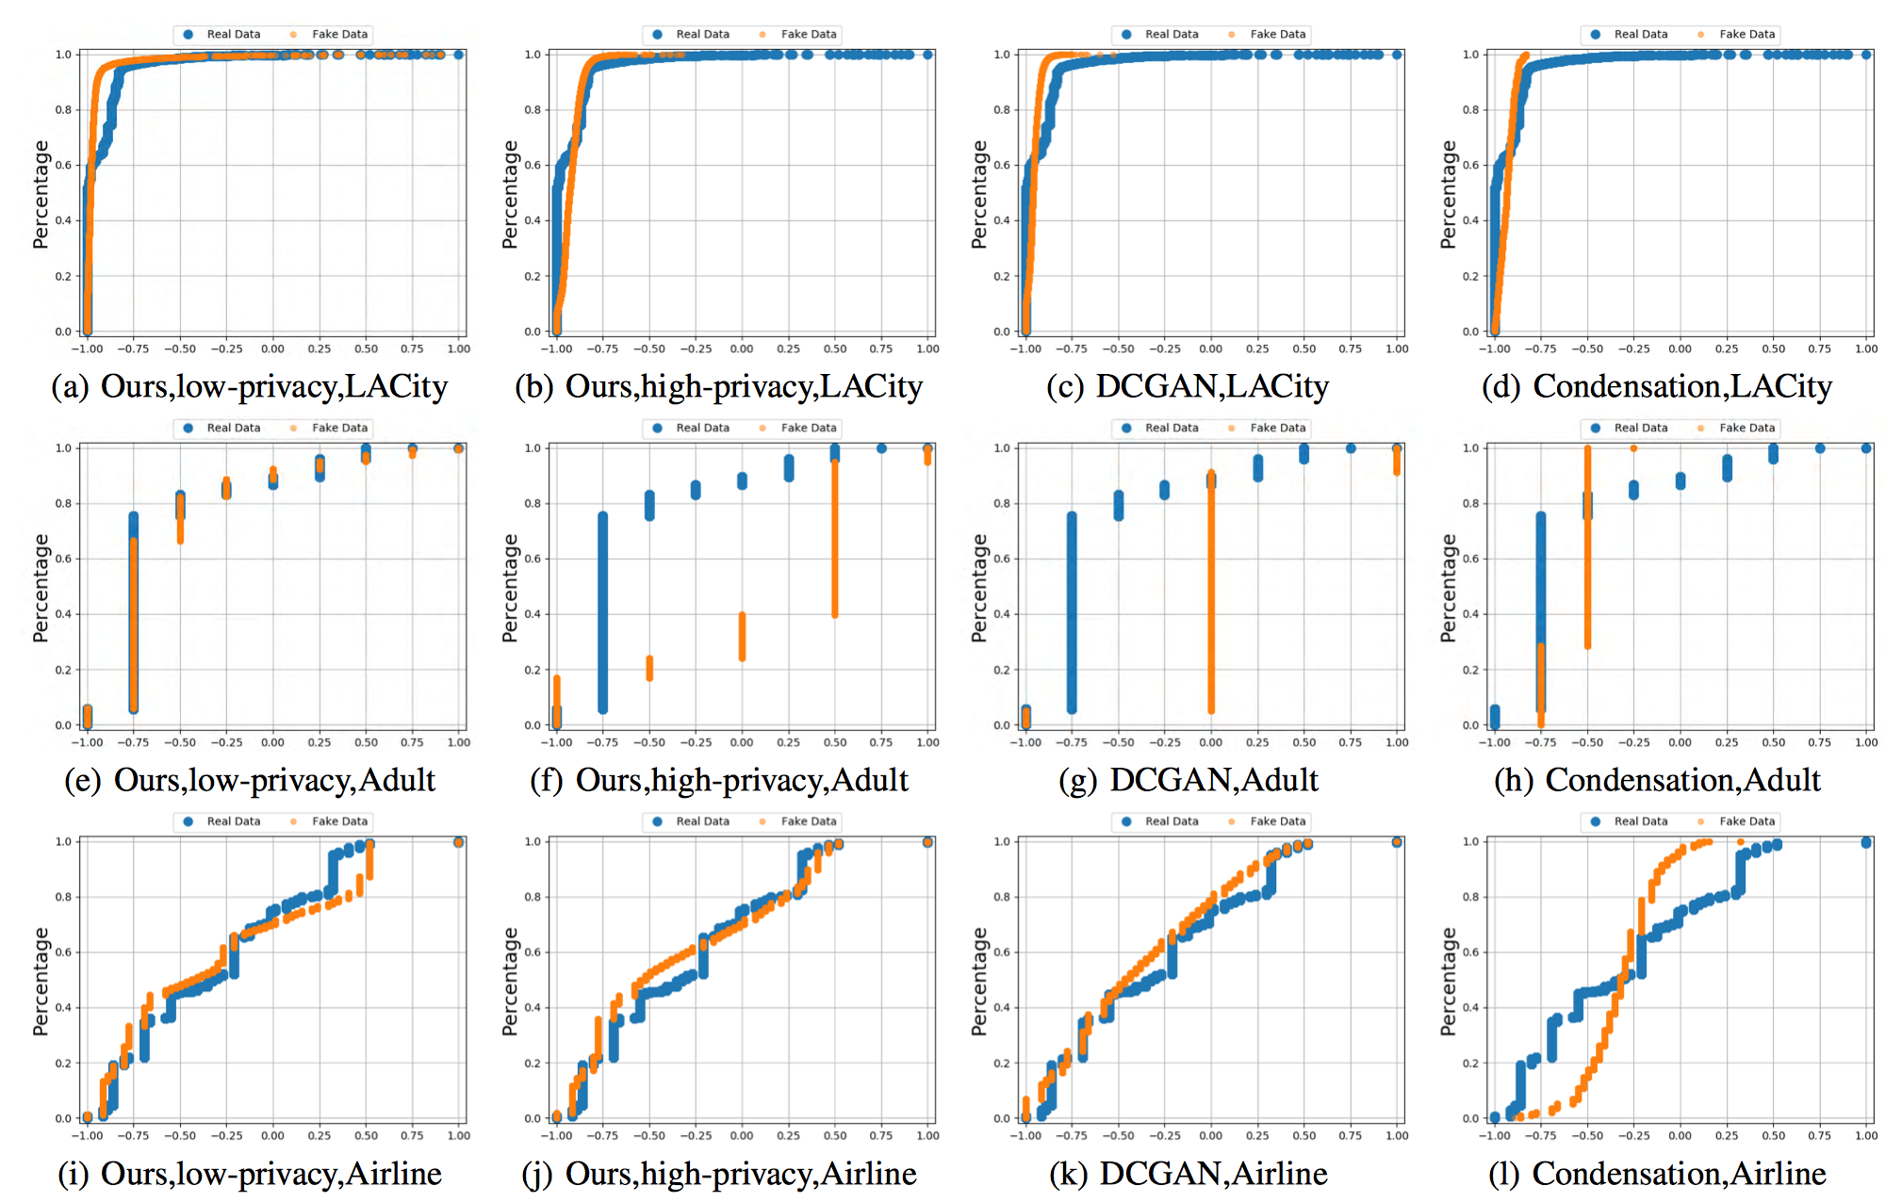
Statistical Comparison
Peking University

Slide 21
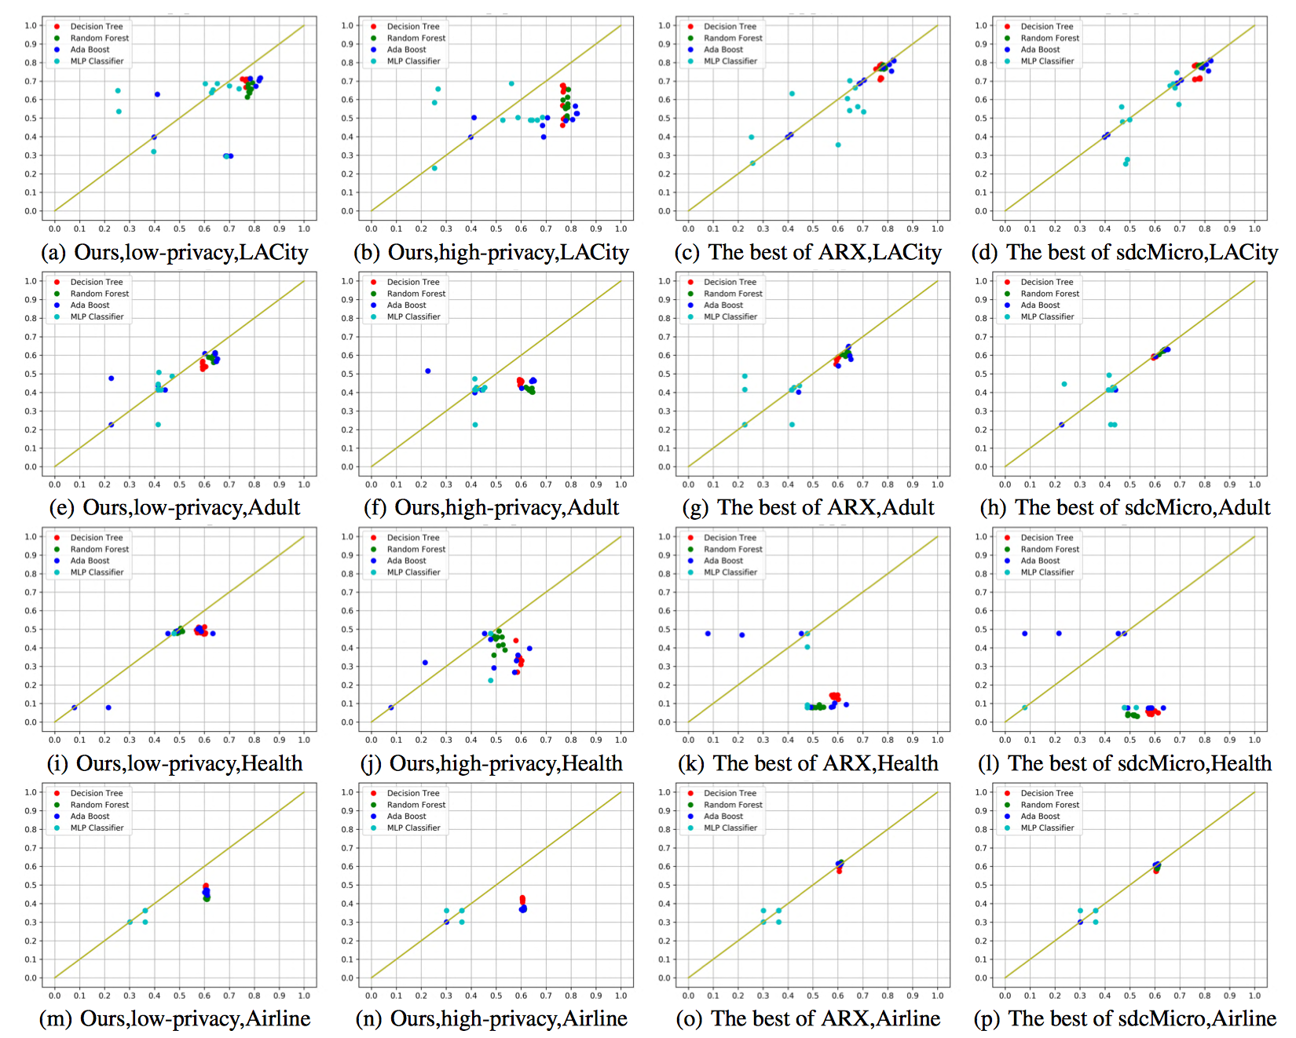
Model Compatibility
Peking University

Slide 22
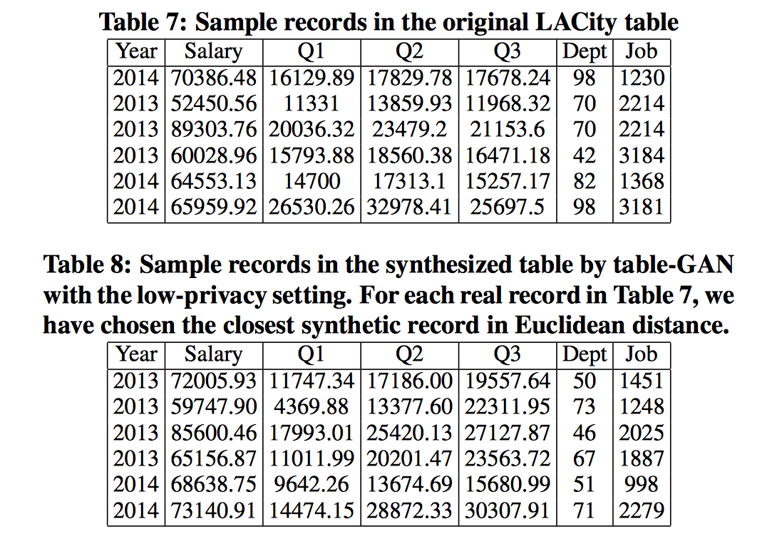
Generation Example
Peking University

Slide 23
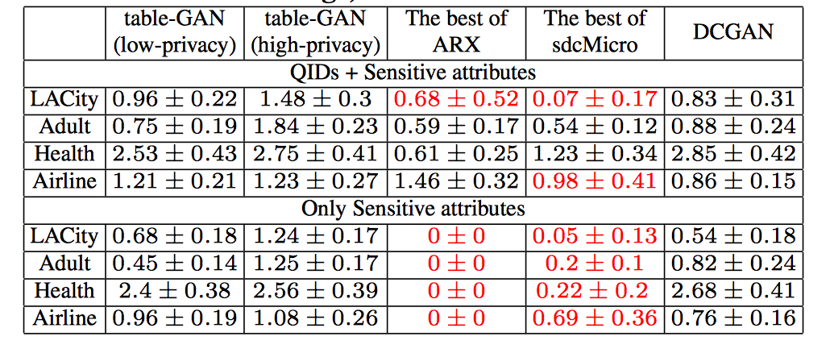
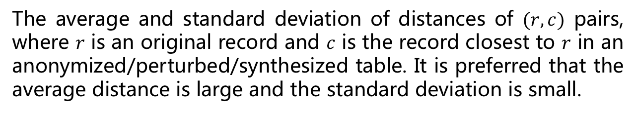
Distance to the Closest Record
Peking University
The average and standard deviation of distances of $(r,c)$ pairs, where $r$ is an original record and $c$ is the record closest to $r$ in an anonymized/perturbed/synthesized table. It is preferred that the average distance is large and the standard deviation is small.

Slide 24
Conclusion
Peking University
This work shows a good model compatibility as anonymization techniques that do not change sensitive attributes.
The first attempt to synthesis general relational databases using deep learning techniques.
Some tricks are not shown in this paper.

Slide 25
Peking University
Q & A

